Slide 1
UNIT 5
LONG BIEN SECONDARY SCHOOL
Welcome everybody to today’s lesson
A closer look 1
Teacher: Nguyen Thu Hang

Slide 2
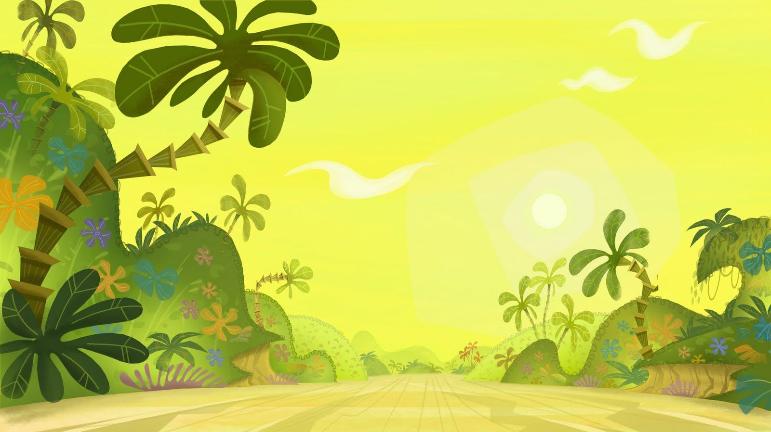
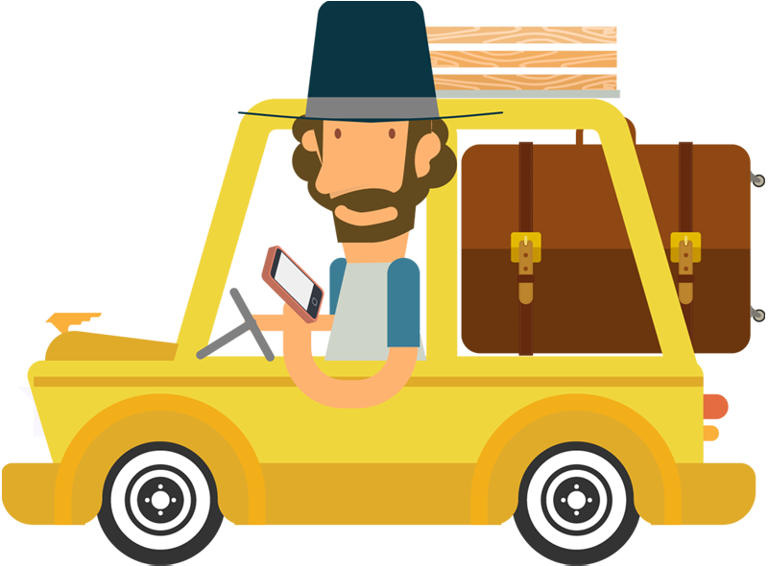

Slide 3
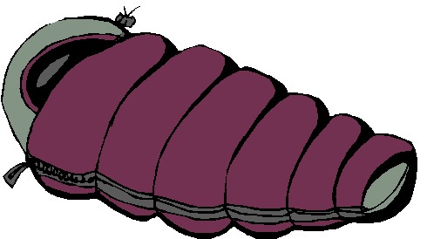
SLEEPING BAG

Slide 4
PLASTER

Slide 5
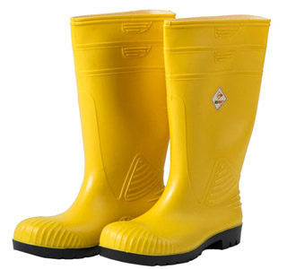
Oh no, my shoes are getting wet !
WALKING BOOTS

Slide 6
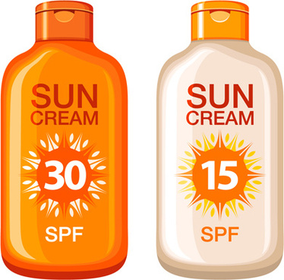
Oh dear! The sunlight is hurting my skin
SUN CREAM

Slide 7
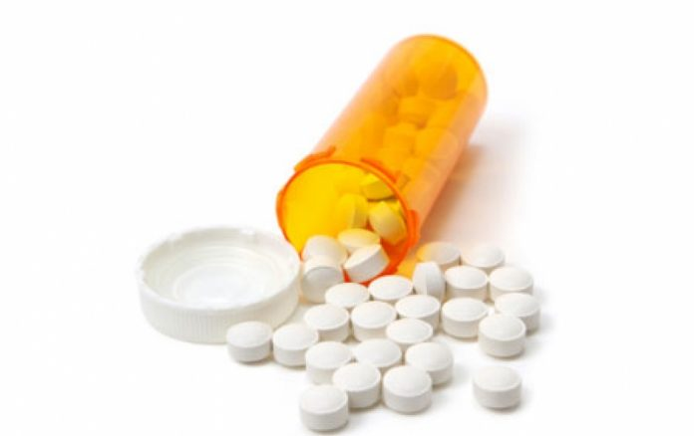
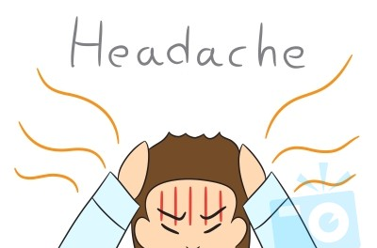
PAINKILLER

Slide 8
WALKING BOOTS
PAINKILLER
PLASTER
SLEEPING BAG
SUN CREAM

Slide 9
PAINKILLER
WALKING BOOTS

Slide 10
SLEEPING BAG
PLASTER
SUN CREAM

Slide 11
MATCHING
TRAVEL ITEMS
1. plaster
2. walking boots
3. painkiller
4. sleeping bag
5. sun cream
Kem chống nắng
Thuốc giảm đau
Túi ngủ
Băng dán
Ủng

Slide 12
Vocabulary
TRAVEL ITEMS
1. plaster (n):
2. walking boots (n):
3. painkiller (n):
4. sleeping bag (n):
5. sun cream (n):
Băng dán
Ủng
Thuốc giảm đau
Túi ngủ
Kem chống nắng

Slide 13
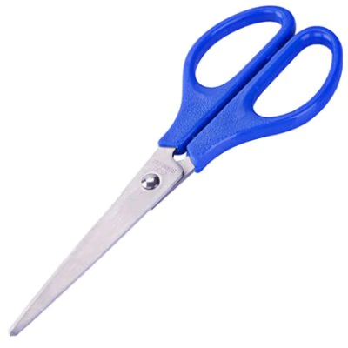
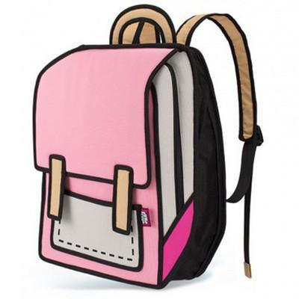
EXERCISE 1
scissors
walking boots
sun cream
backpack
sleeping bag
painkiller
plaster
compass

Slide 14
EXERCISE 2
Complete the sentences (p.50)

Slide 15
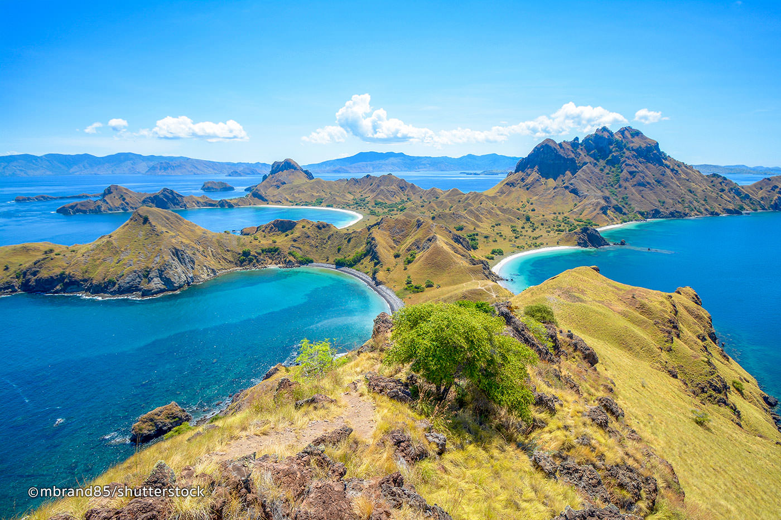
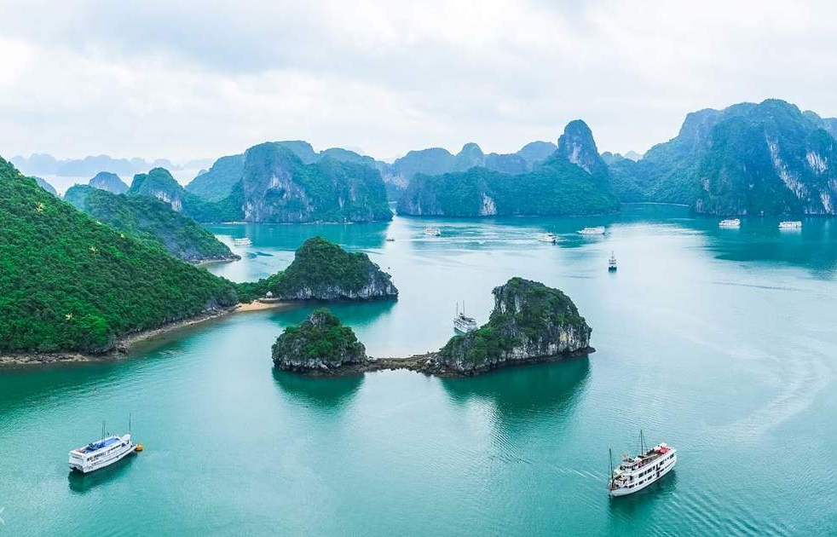
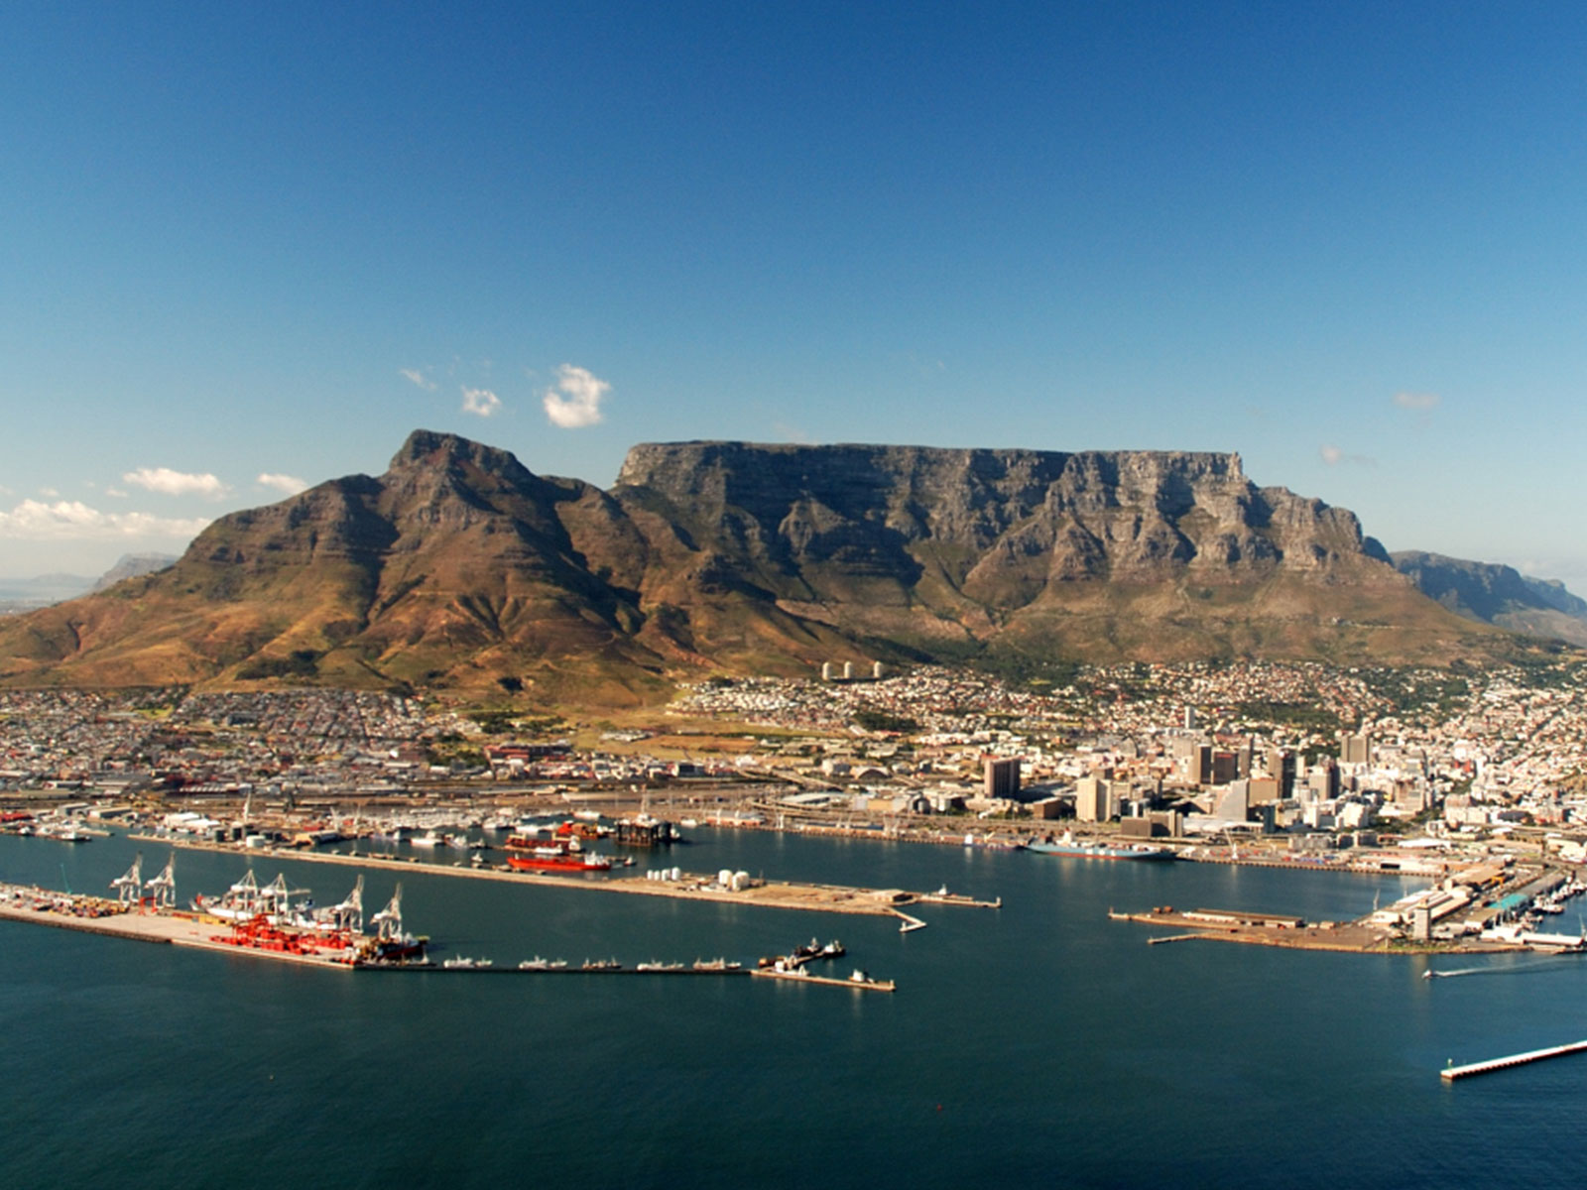
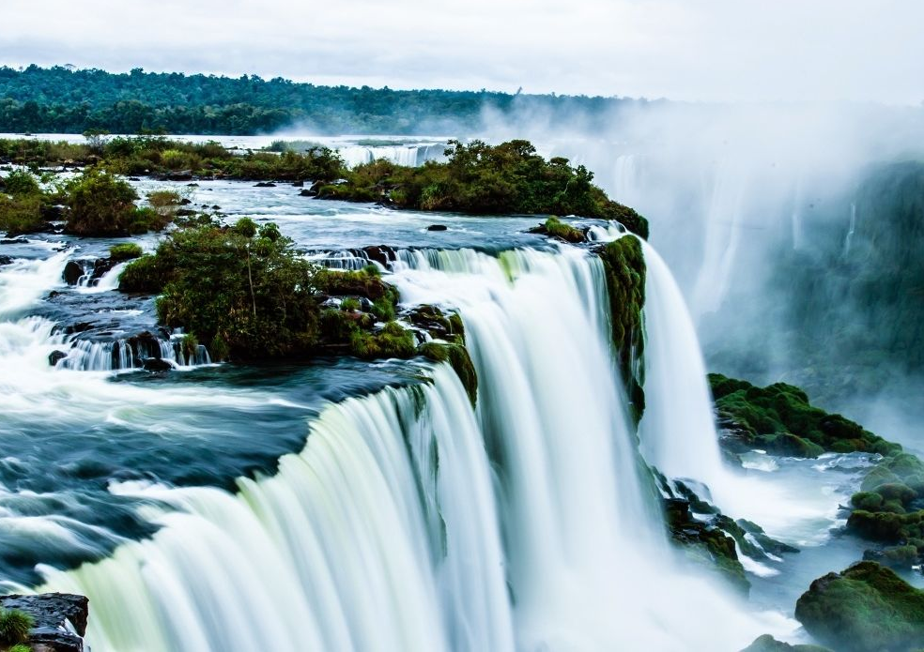
KOMODO NATIONAL PARK
JEJU
HALONG BAY
TABLE MOUNTAIN
AMAZON
PUERTO
PRINCESA
IGUAZU FALLS

Slide 16
compass
1. We are lost. Pass me the ………………………

Slide 17
sun cream
2. It’s so hot today. I need to take some……………

Slide 18
painkiller
3. My head hurts. I need to take a …………………….

Slide 19
backpack
4. I finished packing. All my things are in my …………………...

Slide 20
plaster
5. I walked too much. I need to put a …………….. on my foot.

Slide 21
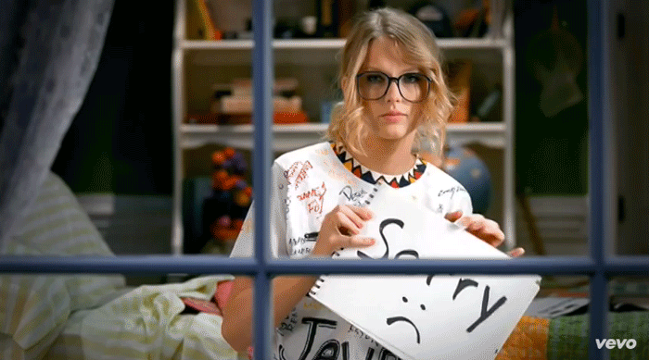

Slide 23
EXERCISE 3
Imagine you and your friends are going to Ha Long Bay, what will you bring?
8
7
6
5
4
3
2
1
USEFULNESS

Slide 24
/t/
/st/
tall
forest
PRONUNCIATION
boat
plaster
top
stop

Slide 25
Exercise 4. Listen and number
1
2
3
4
5
6
7
8
PRONUNCIATION

Slide 26
street
tick
plaster
boot
stop
hot
students
tall
top
study
stand

